Slide 1
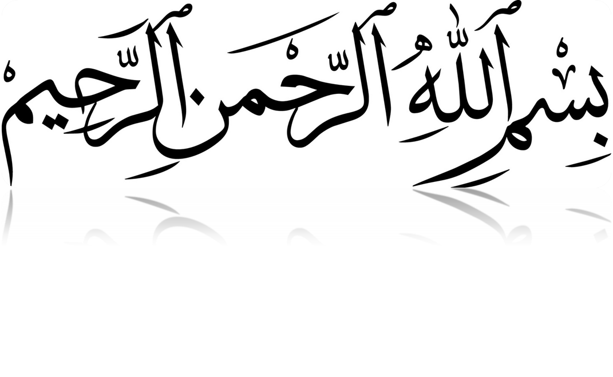

Slide 2
MLC - Medico-Legal-Certificate or
MLR - Medico-Legal-Report
1. Containing all the details of the person and the injuries sustained by him/her in Medico Legal Cases.
2. The injured is produced alongwith injury sheet (نقشہ ضرر) by police constable.
3. the injured may be given first aid treatment as per the established medical protocol to save his life.
4. The dimensions/size of the wound with specification of entrance and exit wounds must be given.

Slide 3
Contd..
5. The medical officer to opine about the fact whether the injured was conscious or otherwise.
6. The medical officer to mention charring or tattooing marks on the wounds if observed.
7. The Medical Officer shall also opine about the level of entrance and exit wounds as to whether these are in the same level or from upward to downwards.

Slide 4
Contd..
8. The blood stained clothes having bullet/cut marks be secured by the medical officer and handed over to the police.
9. The spent bullet or other articles recovered from the person or wounds of the injured be secured, sealed in phial and sent to police.
10. The time of arrival and examination of the injured be recorded.
11. The duration of injury be also recorded.

Slide 5
Contd..
12. The Medical Officer shall also record remarks about the nature of the wounds.
13. The Medical Officer shall specifically mention the factum of referral of the injured for specialized treatment to other Hospital if need arises.
14. The Medical Officer shall mention the cases of L.A.M.A (left against medical advice)

Slide 6
Contd..
15. The injured be issued discharge slip after examination/treatment wherein the nature of injury caused be specified.
16. The nature of injury be specified at the time of examination whether it was lacerated, incised or fire arm injury.
17. The weapon of offence be specified whether it was caused by blunt means, FA or sharp edged weapon.
18. The over writing/cutting in the MLC be avoided and the same be initialed if made.

Slide 7
Contd..
19. The injury sheet be endorsed by the medical officer.
20. The Medical Officer shall mention his full name and designation beneath his signature.
21. The MLC shall also mention the articles given to the constable for handing over to IO.
22. The clothes of the injured and other articles be initialed.
23. The Medical Officer shall furnish certificate regarding the capability of the seriously injured that he is sufficiently in possession of his reason to make a lucid statement and to record report.

Slide 8
Contd…
24. No examination by a medical officer of a living woman’s person shall be made without her consent and without a written order from a Magistrate addressed to the medical officer directing him to make such examination.
25. Signs of struggle be also specified.

Slide 9
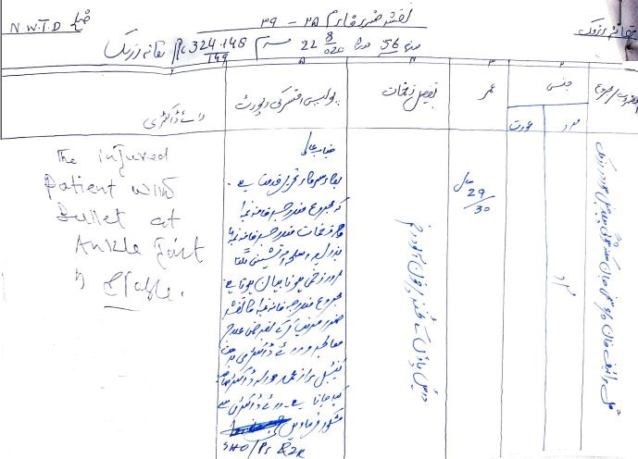

Slide 10
QISAS AND DIYAT ACT 1997
DEFINITIONS (SECTION-299)

Slide 11
QISAS
It is not defined in the law. It means equal punishment in other words it is “tit for tat” i.e life for life and an eye for an eye.

Slide 12
DIYAT
SECTION 299 E
The compensation specified in section 323 payable to the heirs of the victim by the offender.

Slide 13
ARSH
SECTION 299 B
The Compensation specified in “Qisas and Diyat ordinance 1990” to be paid by the offender to the victim

Slide 14
DAMAN
SECTION 299 D
The compensation determined by the court to be paid by the offender to the victim.

Slide 15
AUTHORISED MEDICAL OFFICER SECTION 299 C
A Medical officer or a Medical Board who so ever designated, Authorized by the provincial Government.

Slide 16
LAW RELATING TO HURT
HURT
SECTION-332
Causing of Pain, harm, disease, infirmity, injury or impairing, disabling, dismembering any organ of the body or part there of without causing death.

Slide 17
ITLAF-I-UDW
SECTION-333
CLASSIFICATION ACCORDING TO THE PART OF THE BODY INVOLVED
Causing of dismemberment, Amputation, Severement of any limb or organ of the body.

Slide 18
ITLAF-SALAHIYYAT-I-UDW
SECTION-335
Destroying or permanently impairing the function or capacity of an organ of the body or causing permanent disfigurement.

Slide 19
SHAJJAH
SECTION 337
Hurt on the Head/Face which does not amount to ITLAF-I-UDW or ITLAF-I-SALAHIYYAT-I-UDW

Slide 20
TYPES OF SHAJJAH
337 (a) SHAJJAH-I-KHAFIFAH
Without exposing bone
337 (b) SHAJJAH-I-MUDIHAH
Exposing bone without fracture
337 (c) SHAJJAH-I-HASHIMAH
Fracturing bone without dislocating

Slide 21
SHAJJAH
337 (d) SHAJJAH-I-MUNAQQILAH
Fracturing bone dislocating of bone.
337 (e) SHAJJAH-I-AMMAH
Fracturing of bone and wound touching membranes
337 (f) SHAJJAH-I-DAMIGHAH
Fracturing and rupturing of membranes

Slide 22
JURH
SECTION 337 B
Hurt on parts of body other than head/face bearing marks of wound temporary or permanent .

Slide 23
TYPES OF JURH
JAIFAH
337 – C
Injury extending to body cavity of the Trunk
GHAYR- JAIFAH
337- E
Jurh not amounting to JAIFA.

Slide 24
TYPES OF GHAYR-JAIFA
DAMIYAH
SECTION 337 – E (a)
Rupture of skin with bleeding
BADIAH
SECTION 337- E (b)
Cutting of flash without exposing bone
MUTALAHIMAH
SECTION 337- E (c)
Lacerating of flash

Slide 25
TYPES OF GHAYR-JAIFA
MUDIHAH
SECTION 337- E (d)
Exposing bone without fracture
HASHIMAH
SECTION 337- E (e)
Fracturing bone without dislocating
MUNAQQILAH
SECTION 337- E (f)
Fracturing bone dislocating of bone.

Slide 26
SECTION 337- L 1
Whoever causes hurt, not mentioned before, which endangers life or which causes the sufferer to remain in severe bodily pain for twenty days or more or renders him unable to follow his ordinary pursuits for twenty days or more.

Slide 27
SECTION 337- L 2
Whoever Causes hurt not covered by subsection (1).

Slide 28
Thank you
Questions?

